Slide 1
Chapter 02 – Computer Evolution and Performance
Week – 02
10- 14 September

Slide 2
Main Memory (RAM)
This module is called memory, or main memory called (RAM).
Thus temporary storage of both code/inst. and results/data is needed.
RAM (Random access memory) is directly accessed by the CPU. Volatile
RAM is usually in GBs. Each location in RAM is accessed by an address
RAM is a memory that needs to be refreshed every few milli-seconds.
It is made up of DRAM cells. The technology it uses is called DDR-4.
‘DDR’ stands for ‘double data rate’. Data is transferred twice per clock.
Each location in RAM is called a WORD e.g. data or instruction.

Slide 3
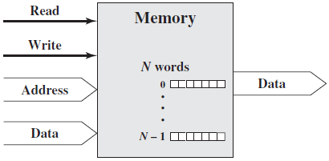
Memory Module and its Data Exchange
A memory module consists of N words of equal length.
Each word is assigned a unique numerical address from (0, 1, …, N-1).
A word of data can be read from or written into the memory.
The nature of operation is indicated by read and write control signals.
The location for the operation is specified by an address.
Note: The wide arrows
represent multiple signal
lines, carrying multiple bits
of information in parallel.

Slide 4
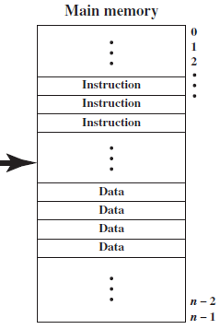
Memory Module
RAM is usually accessed in ‘memory cycles’. Consisting of four system clocks.
First control signal is delivered to RAM, then address, RAM decodes address and places Data on Data bus.
The data or instructions found in RAM are usually clustered. (adjacent to other)
Read: To get data from RAM.
Write: To store data to RAM.

Slide 5
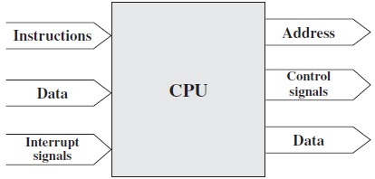
Processor Module and its Data Exchange
The processor reads in instructions and data, writes out data after processing.
It uses control signals to control the overall operation of the system.
It also receives interrupt signals and acts on them.

Slide 6
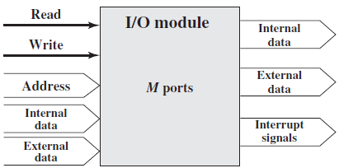
I/O Module and its Data Exchange (Bridge)
From the computer’s point of view, I/O is exactly similar to memory.
There are two operations read and write. It acts as a Bridge.
An I/O module may control more than one external device.
We refer to each of the interfaces to an external device as a port and give each a unique address (e.g., 0, 1, …, M-1).
An I/O module may be able to send interrupt signals to the processor.
Input
Receive data from peripheral
Receive data from computer
Output
Send data to computer
Send data to peripheral
Internal Data: Data inside system.
External Data: Data outside system.
Input from device

Slide 7
Types of Data Transfer b/w Computer Modules
The interconnection structure must support the following types of transfer:
Memory to processor: The processor reads an instruction or a unit of data from memory.
Processor to memory: The processor writes a unit of data to memory.
I/O to processor: The processor reads data from an I/O device via an I/O module. (Input)
Processor to I/O: The processor sends data to the I/O device. (Out)
I/O to or from memory: Direct memory access (DMA) via I/O.

Slide 8
Topics to Cover
2.1 – A Brief History of Computers
The First, Second, Third and Later Generations of Computers
The Von-Neuman Machine
The IAS Computer
2.2 – Designing for Performance
2.3 – Multicore Processors
2.4 – The Evolution of the Intel x86 Architecture
2.6 - Performance Assessment

Slide 9
2.1 A Brief History of Computers
The First Generation : Vacuum Tubes for digital logic elements and memory.
Electronic Numerical Integrator And Calculator (ENIAC)
Started 1943 (During World War II)
Eckert and Mauchly were the Developers
University of Pennsylvania, Professors
Trajectory tables for weapons, without tables they were useless
Finished 1946
Too late for war effort
Used until 1955

Slide 10
ENIAC - Details
Decimal (not binary)
20 accumulators of 10 digits each
18,000 vacuum tubes
30 tons weight
15,000 square feet area
140 kW power consumption
Programmed manually by switches (Drawback)
5,000 additions per second

Slide 11
Commercial Computers (UNIVAC)
1947 - Eckert-Mauchly Computer Corporation
UNIVAC I (Universal Automatic Computer)
US Bureau of Census 1950 calculations
Became part of Sperry-Rand Corporation
Late 1950s - UNIVAC II
Faster
More memory

Slide 12
UNIVAC Series (Investment Plan)
The UNIVAC II, which had greater memory capacity and higher performance than the UNIVAC I, was made.
It illustrated several trends that have remained characteristic of the computer industry.
Advances in technology allowed to build larger and powerful systems.
Second, each company tries to make its new machines backward compatible with the older machines.
This means that the program written for the older machines can be executed on the new machine.
This strategy is adopted to retain the customer base; that is when a customer decides to buy a new machine, he buys from same series.

Slide 13
IBM Machines
Punched-card processing equipment
1953 - the 701 Series
IBM’s first stored program computer
Scientific calculations
1955 - the 702 Series
Business applications
Lead to 700/7000 series

Slide 14
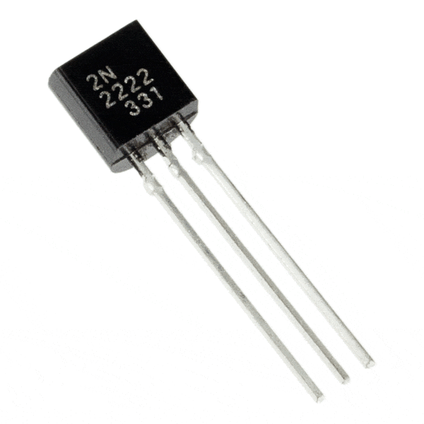
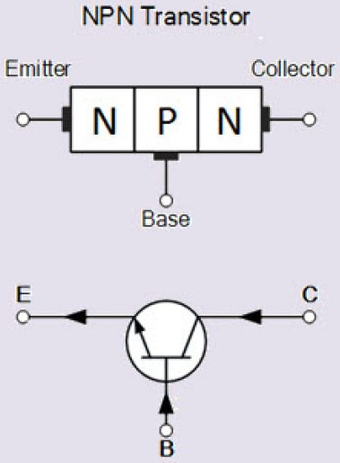
2.1 A Brief History of Computers
The Second Generation : Transistors (Electronic Switch)
Replaced vacuum tubes (they generate heat, were bulky, unreliable)
Invented 1947 at Bell Labs
Two state device. ON/OFF.
Transistor Advantages:
Smaller and Cheaper
Less heat dissipation
Solid State device (ON/OFF)
Made from Silicon (Sand)

Slide 15
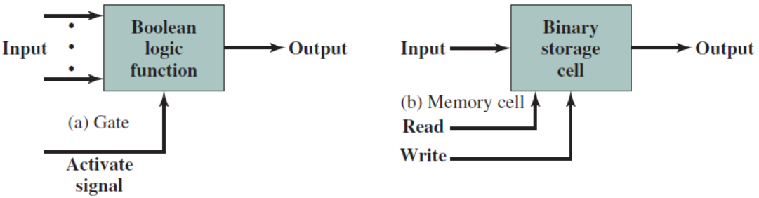
ALU (Logic Gates) and Memory (Cells)
In a ‘digital computer’, only two fundamental types of components are required: gates and memory cells. Both are made from Transistor.
Gate is a device that implements a simple Boolean or Logical function
For example: An AND gate performs If A and B are true then C is True.
Memory Cell is a device that can store 1-bit of data; e.g. 1 or 0,On/Off
Memory Cells provide data storage, whereas Gates provide data processing.

Slide 16
Improvements in the Second Generation
‘Computer generations’ are classified based on the fundamental hardware technology employed e.g. transistors.
Each new generation is characterized by greater processing performance, larger memory capacity, and smaller size than the previous one.
Also the second generation saw the introduction of more complex arithmetic and logic units and control signals, the use of high level programming languages, and the provision of system software with the computer.
‘System software’ provide the ability to load programs, move data to peripherals, and to perform common computations, similar to Windows.

Slide 17
Transistor Based Computers
Second generation machines
NCR & RCA initially produced small transistor machines
IBM 7000 series came later
DEC (Digital Equipment Corporation) - 1957
Produced its first computer PDP-1
This computer and this company began the mini-computer phenomenon that became so prominent in the third generation.

Slide 18
What is a Computer Program?
A computer program is a collection of instructions (written in logical order) that performs a specific task when executed by a computer.
A computer executes the program's instructions in a central processing unit (CPU).
A computer program is usually written by a computer programmer in a programming language e.g. Assembly language or C++.
From the program in its human-readable form or source code, a compiler can derive machine code.
Machine code—a form consisting of instructions that the computer can directly execute.

Slide 19
The Von Neumann Machine
The task of entering and altering programs for the ENIAC was tedious.
Von-Neuman gave the idea of a stored-program concept and his new stored-program computer is referred to as the IAS computer.
Stored-program concept: A program could be represented in a form suitable for storing in the memory alongside the data.(same memory)
Then, a computer could get its instructions by reading them from memory, and a program could be set or altered by setting the values of a portion of memory.
The IAS (Institute of Advanced Studies) computer, is the prototype of all subsequent general-purpose computers.

Slide 20
The IAS Computer (See Fig. Next Slide)
Four main components of the IAS computer are:
1) Main memory 2) ALU 3) Control unit 4) Input/Output (I/O)
A main memory, which stores both data and instructions.
An arithmetic and logic unit (ALU) capable of operating on binary data.
A control unit, which interprets the instructions in memory and causes them to be executed.
Input-Output (I/O) equipment operated by the control unit.

Slide 21
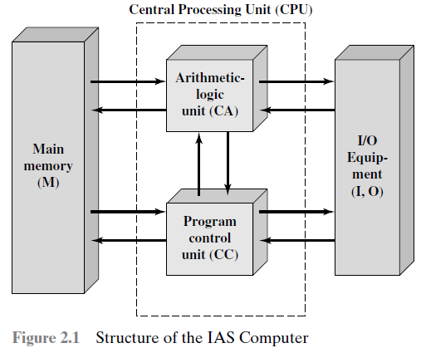
Structure of the IAS Computer
Stored Program concept.
Main memory stores programs and data.
ALU operates on binary data.
Control unit interprets instructions from memory and executes them.
Input and output equipment is operated by control unit.
Data
Instructions

Slide 22
IAS Structural Components
Since the device is primarily a computer, it will have to perform the elementary operation of arithmetic most frequently.
These are addition, subtraction, multiplication, and division.
This requires a central arithmetic (CA) part of the device to exist.
The logical control of the device, that is, the proper sequencing of its operations, can be most efficiently carried out by a central control (CC) organ.
Any device that is to carry out long and complicated sequences of operations (specifically of calculations) must have a memory (M) unit.

Slide 23
IAS Structural Components
The device must have organs to transfer information from the outside medium into its specific parts CPU and memory.
These organs form its input.
The device must have organs to transfer from its specific parts CPU and memory into the outside medium.
These organs form its output.

Slide 24
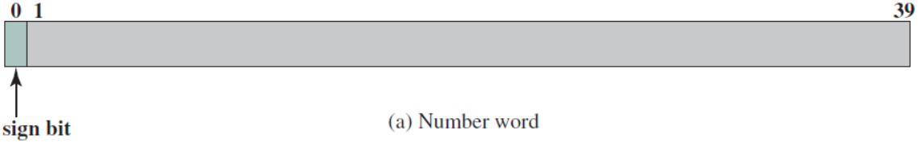
The Von-Neuman IAS Arcthitecture
All of today’s computers have this same general structure and function and are thus referred to as von Neumann machines.
The main memory of the IAS consisted of 4096 storage locations, called words.
Each word has a width of 40 binary digits (bits). (4096 x 40 bit words)
Both data and instructions are stored there as words.
Numbers are represented in binary form, and each instruction is a binary code.
Each number is represented by a sign bit and a 39-bit value.

Slide 25
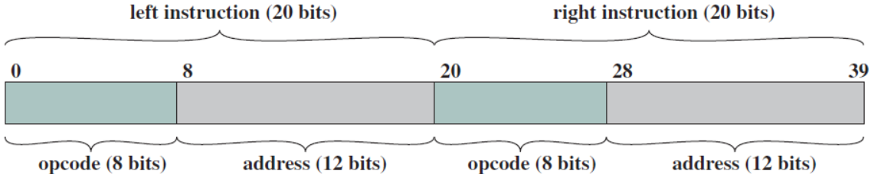
IAS Memory Formats
A word may also contain two 20-bit instructions.
Each instruction consisted of an 8-bit operation code (opcode) specifying the operation to be performed.
And a 12-bit address designating one of the words in memory (numbered from 0 to 4095).

Slide 26
The ‘Registers’ for ALU and Control Unit
The control unit operates the IAS by fetching instructions from memory and executing them one at a time.
Both the control unit and the ALU contain storage locations in CPU, called registers, defined as follows:
ALU Registers:
Accumulator (AC)
Multiplier Quotient (MQ)
Memory Buffer Register (MBR)
Program Control Unit Registers:
Memory Address Register (MAR)
Instruction Register (IR)
Instruction Buffer Register (IBR)
Program Counter (PC)

Slide 27
ALU Registers
Memory Buffer Register (MBR): contains a 40-bit word to be stored in memory or sent to the I/O unit, or is used to receive a word from memory or from the I/O unit.
Accumulator (AC) and Multiplier Quotient (MQ): are employed to hold temporarily operands and results of ALU operations.
For example, the result of multiplying two 40-bit numbers is an 80-bit number; the most significant 40 bits are stored in the AC and the least significant in the MQ.

Slide 28
Program Control Unit Registers
Memory Address Register (MAR): is a 12-bit register that specifies the address in memory of the word to be written from or read into the MBR.
Instruction Register (IR): contains the 8-bit opcode instruction being executed by the ‘control circuits’ e.g. add, multiply.
Instruction Buffer Register (IBR): is employed to hold temporarily the right-hand instruction of 20-bit from a word in Memory. While the left hand instruction goes to IR and MAR (20-bit).
Program Counter (PC): contains the address of the next instruction pair to be fetched from memory.
(Half)

Slide 29
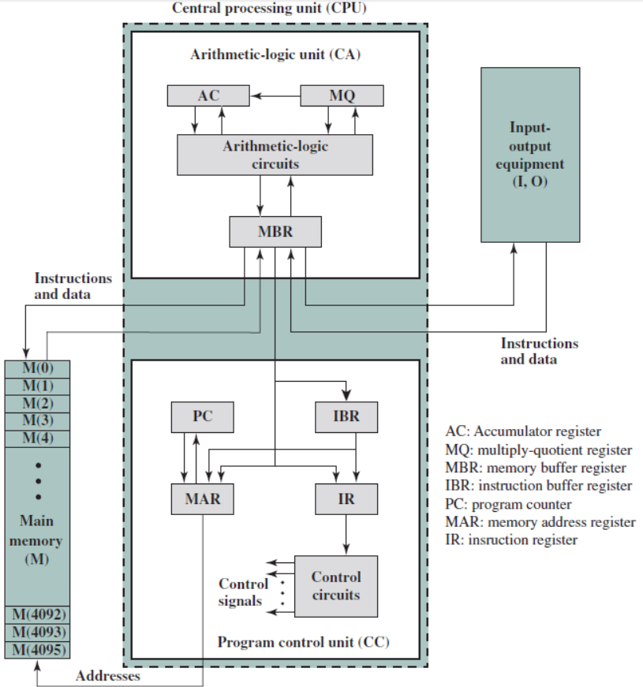
Structure of IAS
40-bits
L.H.I
R.H.I
Load
Add
20-bit
RHI
12-bit
Address
8-bit
Opcode
Add

Slide 30
Steps of ‘Instruction Cycle’: Fetch-Decode-Execute
To execute a program, the program code is copied from secondary storage into the main memory.
In a program, each machine code instruction takes up a slot in the main memory.
These slots (or memory locations) each have a unique memory address.
The CPU's program counter is set to the memory location where the first instruction in the program has been stored and execution begins.
PC register tells the CPU the order of instructions, program is running.
When a program is being executed, the CPU repeats this cycle again.

Slide 31
What is an ‘Instruction Cycle’?
An instruction cycle (sometimes called a fetch–decode–execute cycle) is the basic operational process of a computer.
Each ‘instruction cycle’ consists of two sub cycles,
1) Fetch cycle 2) Execute cycle
Instruction cycle is the process by which a computer retrieves a program instruction from its memory called fetch cycle.
Then it determines what actions the instruction dictates, and carries out those actions called execute cycle.

Slide 32
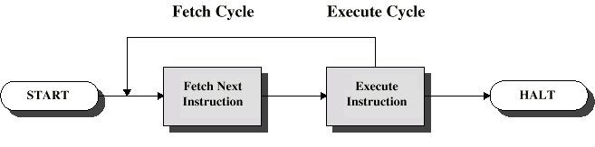
Instruction Cycle
The processing required for a single instruction is called an instruction cycle.
Instruction cycle two steps are referred to as the:
1) Fetch cycle 2) Execute cycle
Fetch cycle is the process by which a computer retrieves a program instruction from its memory.
Then it determines what actions the instruction dictates, and carries out those actions called execute cycle.

Slide 33
The Operation of the IAS (Fetch Cycle)
The IAS operates by repetitively performing an instruction cycle.
Each ‘instruction cycle’ consists of two sub cycles, fetch cycle and execute cycle.
During the fetch cycle, the opcode of the next instruction is loaded into the IR and the address portion is loaded into the MAR.
This instruction may be taken from the IBR, or it can be obtained from memory by loading a word into the MBR, and then down to the IBR, IR and MAR.

Slide 34
The Operation of the IAS (Execute Cycle)
Once the opcode is in the IR, the execute cycle is performed.
The ‘control circuitry’ interprets the opcode and executes the instruction by sending out the appropriate control signals to cause the data to be moved or an operation to be performed by the ALU.
For Example: The opcode: 00000101 is interpreted by the ‘control circuit’ as ADD M(X), and it Adds M(X) to AC; and puts the result in AC.

Slide 35
Operations Performed by IAS Instructions
The IAS computer had a total of 21 instructions.
These instructions can be grouped as follows:
Data transfer: Move data between memory and ALU registers.
Unconditional branch: Normally, the control unit executes instruction in sequence from memory. This sequence can be changed by a branch instruction, which facilitates repetitive operations.
Conditional branch: The branch can be made dependent on a condition, thus allowing decision points.
Arithmetic: Operations performed by the ALU.
Address modify: Permits address to be computed in the ALU and then inserted into instructions stored in memory. Flexible Addressing.

Slide 36
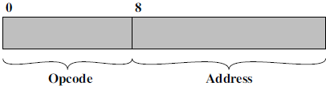
The IAS Instructions
The ‘opcode’ portion (first 8 bits) specify which of the 21 instructions is to be executed. The ‘address’ portion (remaining 12 bits) specifies which of the 4096 memory locations is to be involved in the execution of the instruction.
All of the 21 IAS instructions are categorized as follows:
Data transfer: LOAD, STORE.
Unconditional branch: JUMP.
Conditional branch: JUMP+Condition.
Arithmetic: ADD, SUB, MUL, DIV, LSH, RSH.
Address modify: STOR
8-bit
12-bit

Slide 37
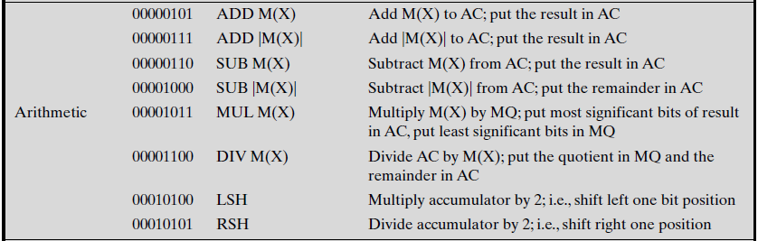
The IAS Instruction Set (Arithmetic)

Slide 38
Harvard Architecture
Under pure von Neumann architecture the CPU can be either reading an instruction or reading/writing data from/to the memory. Both cannot occur at the same time since the instructions and data use the same bus system. In a computer using the Harvard architecture, the CPU can both read an instruction and perform a data memory access at the same time, even without a cache. A Harvard architecture computer can thus be faster for a given circuit complexity because instruction fetches and data access do not contend for a single memory pathway.

Slide 39
The Third Generation: Integrated Circuits (ICs)
A single transistor is a discrete component.
Throughout the 1950 these discrete components were manufactured separately, packaged in their own containers, and soldered together onto circuit boards, which were then installed in computers. The addition of a new transistor has to be soldered again on circuit board.
The entire manufacturing process, from transistor to circuit board, was expensive and cumbersome.
In 1958 came the achievement that revolutionized electronics and started the era of electronics: the invention of the integrated circuit.
It is the integrated circuit that defines the third generation of computers.

Slide 40
Gates and Memory Cells
Skip
In a ‘digital computer’, only two fundamental types of components are required: gates and memory cells.
Gate is a device that implements a simple Boolean or Logical function
For example: An AND gate performs If A and B are true then C is True.
Memory Cell is a device that can store 1-bit of data; e.g. 1 or 0,On/Off
Memory Cells provide data storage, whereas Gates provide data processing.

Slide 41
Micro-Electronics
Literally means “small electronics” has tremendously improved speed.
There has been a consistent trend toward the reduction in size of digital electronic circuits thus leading to ‘microelectronics’.
A computer is made up of (logic) gates, memory (storage) cells and interconnections. Both of them are made from transistors.
The integrated circuit uses the fact that such components, and paths can be fabricated onto a semiconductor such as Silicon wafer (Chip).
To fabricate an entire circuit in a tiny piece of silicon, in this way many transistors can be produced at one time on a single wafer of silicon.

Slide 42
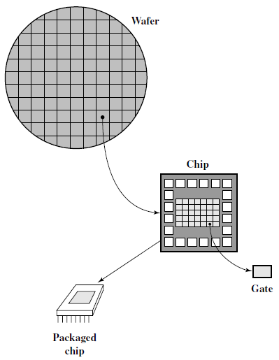
Relationship among Wafer, Chip, and Gate
A thin wafer of silicon is divided into a matrix of small areas, a few millimetres square.
The identical circuit pattern is fabricated in each area, and then wafer is broken up into chips.
Each chip consists of many gates and/or memory cells.
These chips can be connected on a PCB to produce complex circuits.

Slide 43
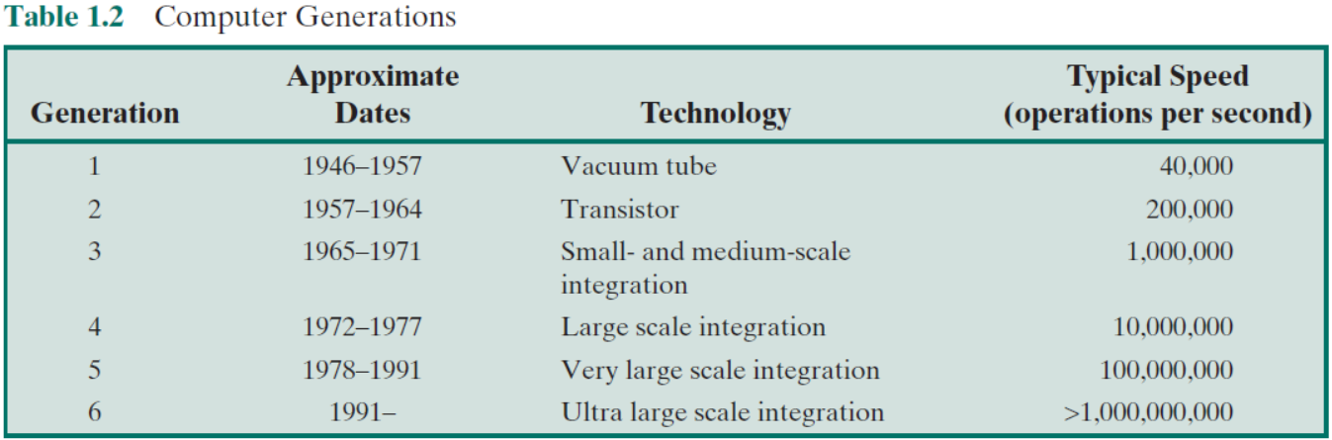
Growth in Transistor Count on IC’s
Initially, only a few gates or memory cells could be built on an IC.
As time went on, the growth of these components on an IC increased.
(SSI)
(LSI)
(VLSI)
(ULSI)

Slide 44
Moore’s Law
Gordon Moore, co-founder of Intel, in 1965 presented his famous law.
Moore observed that the number of transistors that could be put on a single chip was doubling every year (12 months).
Furthermore he predicted that this pace would continue into the near future. Predicted increased density of components on a single chip.
To the surprise of many, the pace continued year after year and decade after decade.
The pace slowed to a doubling every 18 months in the 1970s but has sustained that rate ever since.

Slide 45
Consequences of Moore’s Law
The consequences of Moore’s law are profound:
Cost of a chip has remained almost unchanged during this period of rapid growth in chip density. Cost of Logic and memory has fallen.
Because logic and other memory elements are placed closer together on more densely packed chips, the electrical path is shortened, increasing operating speed.
The computer size becomes smaller giving increased flexibility.
There is a reduction in power and cooling requirements.
The interconnections between components on the IC are much more reliable. An IC as a whole provides only a single connection.
Fabrication cost is same.

Slide 46
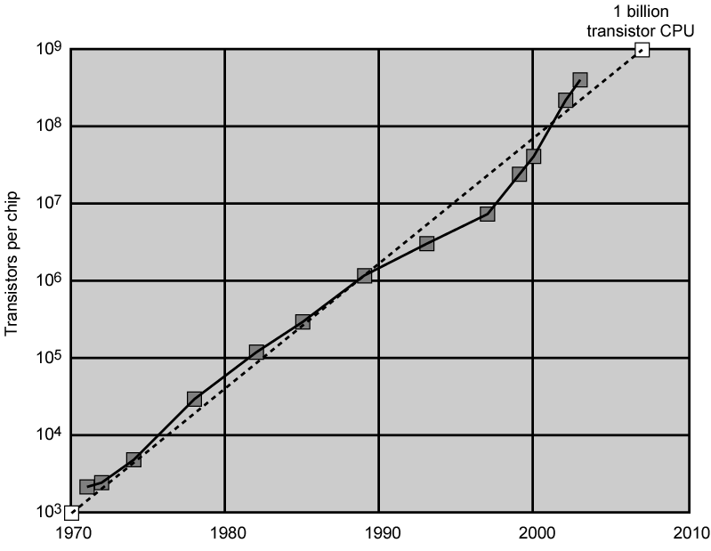
Growth in CPU Transistor Count

Slide 47
Preparatory Questions (Week 2)
Q1. What is a ‘stored program’ computer?
Q2. Define ‘ALU Registers’ of the IAS?
Q3. Define ‘Program Control Unit Registers’ of the IAS?
Q4. Define the structure of IAS computer in detail?
Q5. Explain the consequences of Moore’s law?

Slide 48
Next Class Topics
Later Generations
2.2 Designing for Performance
2.3 Multicore Processors
2.4 The Evolution of Intel Architecture
2.6 Performance Assessment
--

